Slide 1
Phase Transformation

Slide 2
Phase transformations (change of the microstructure) can be divided into three categories:
Diffusion-dependent with no change in phase composition or number of phases present (e.g. melting, solidification of pure metal, allotropic transformations, recrystallization, etc.)
Diffusion-dependent with changes in phase compositions and/or number of phases (e.g. eutectic or eutectoid transformations)
Diffusionless phase transformation - by cooperative small displacements of all atoms in structure, (e.g. martensitic transformation )
Diffusion-dependent phase transformations can be rather slow and the final structure often depend on the rate of cooling/heating.

Slide 3
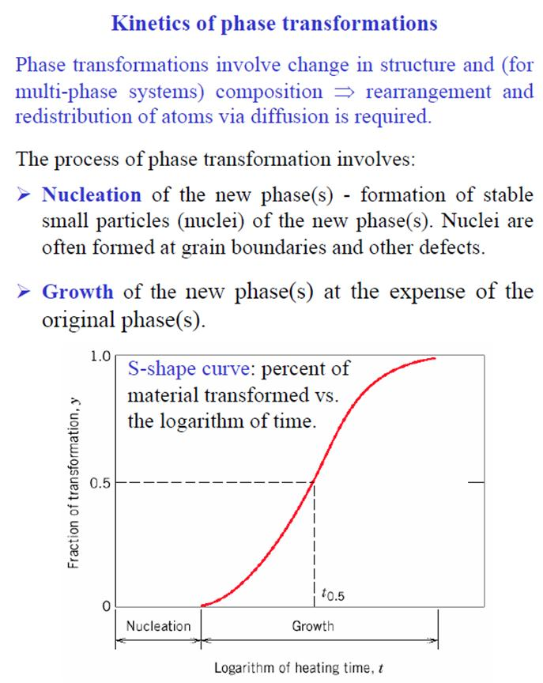

Slide 4
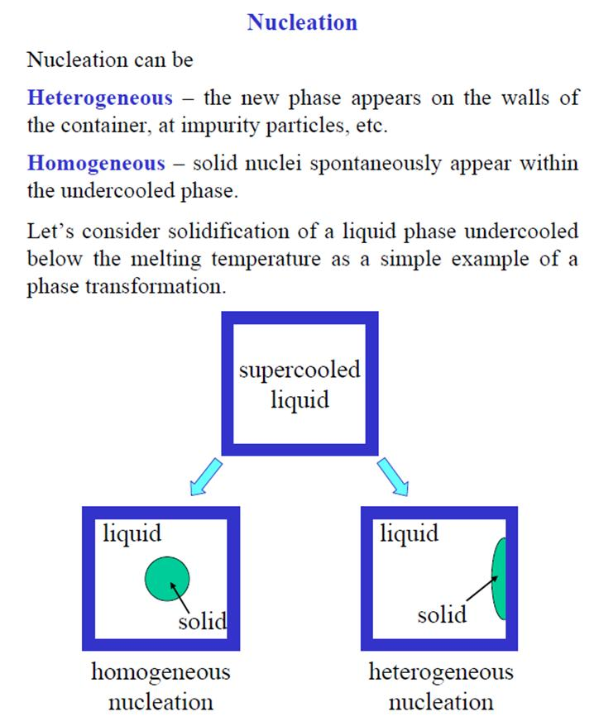

Slide 5
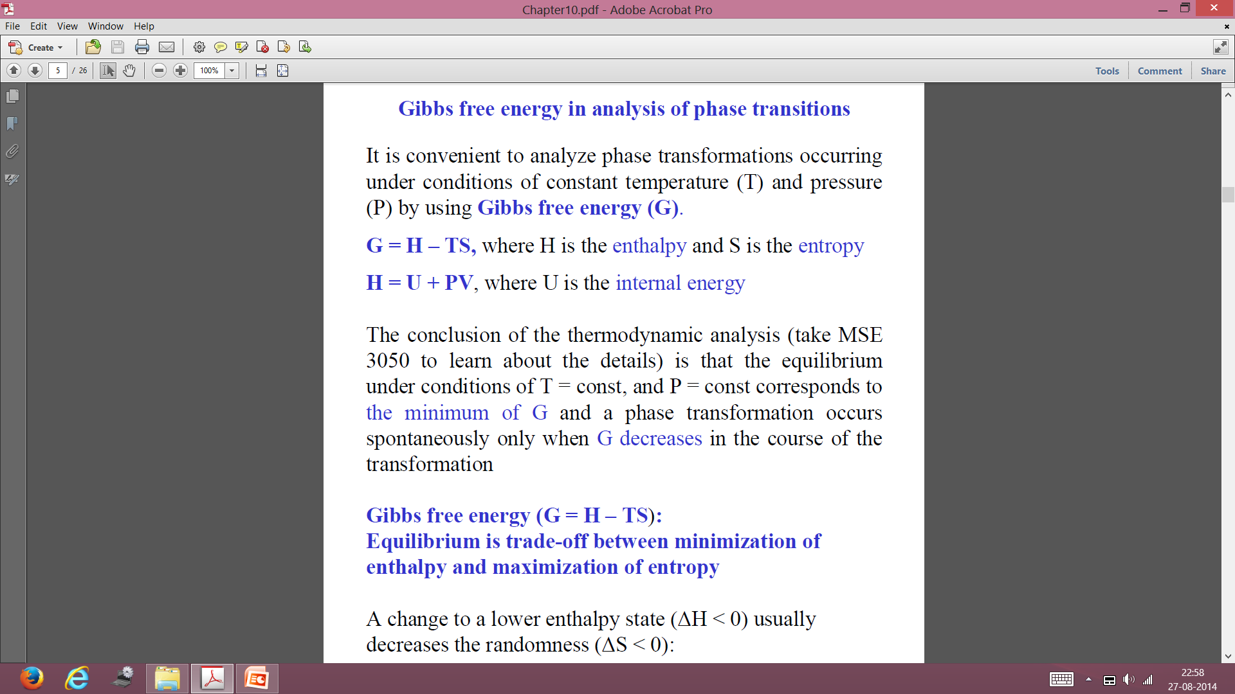
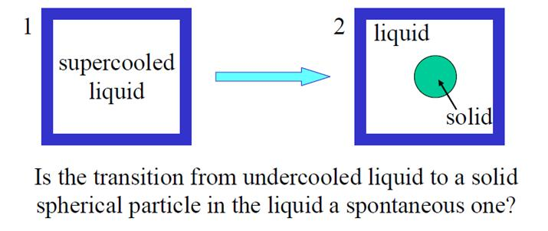
A phase transformation occurs spontaneously only when G decreases in the course of the transformation

Slide 6
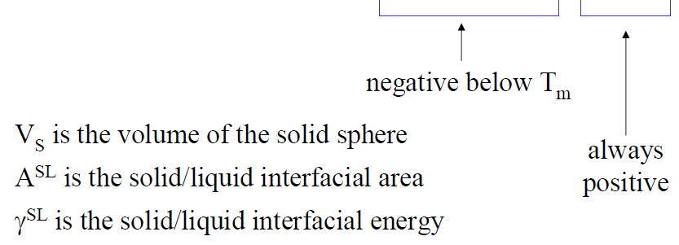
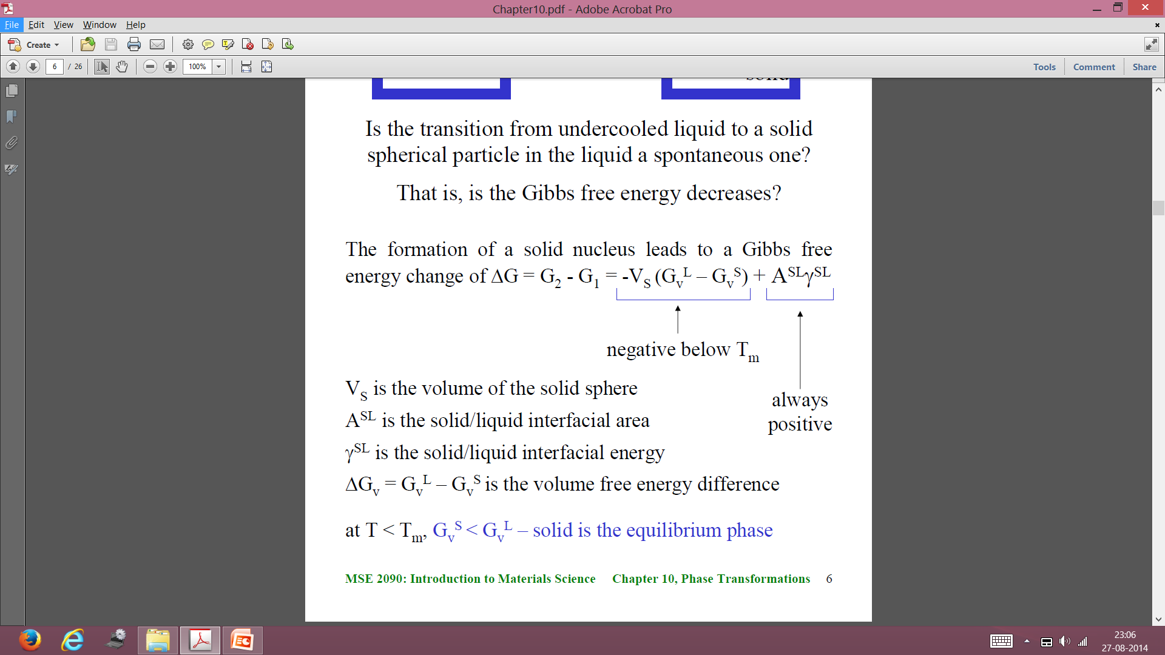
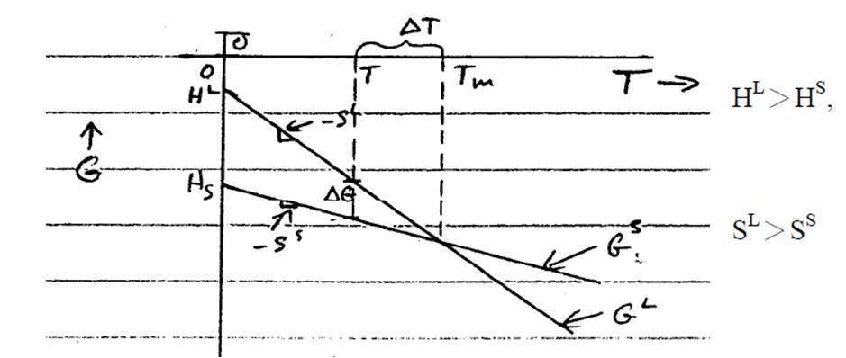
The formation of a solid nucleus leads to a Gibbs free energy change of
Free energy change per unit volume. Below T_{m}, it is -ve

Slide 7
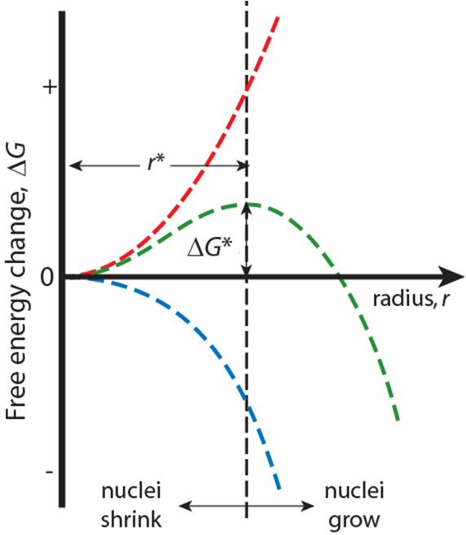
Homogeneous Nucleation & Energy Effects
Surface Free Energy- Energy needed to make an interface)
γ = surface tension
ΔG_{T} = Total Free Energy
= ΔG_{S} + ΔG_{V}
Volume (Bulk) Free Energy –
releases of energy due to formation of solid
r* = critical nucleus: nuclei < r* shrink; nuclei>r* grow (to reduce energy)
at r=r*,

Slide 8
Homogeneous nucleation
at r=r*,
ΔH_{v}=L_{v} is latent heat of solidification
Therefore,
Both r* and ΔG* decrease with increasing undercooling

Slide 9
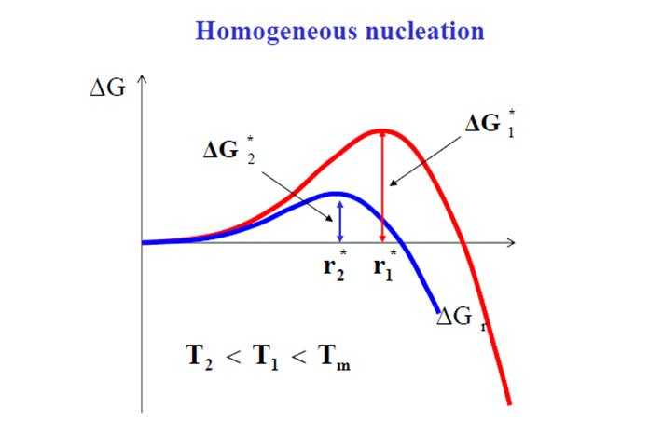
Both r* and ΔG* decrease with increasing undercooling

Slide 10
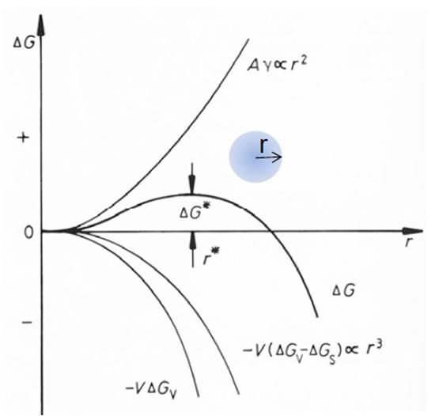
Homogeneous nucleation in solid
Both r* and ΔG* increase because of strain energy involved in solid state transformation

Slide 11
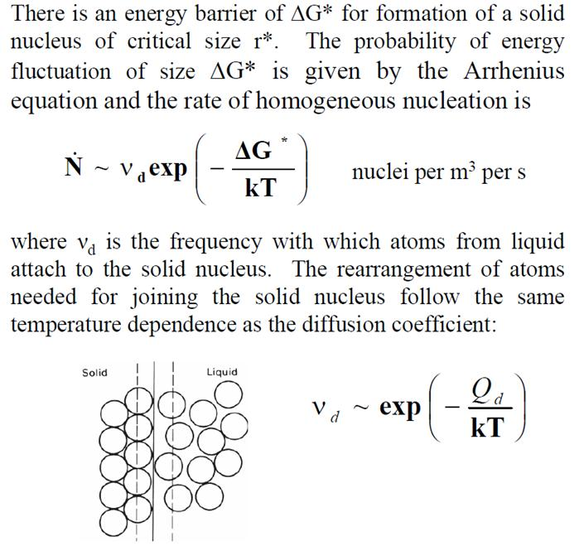
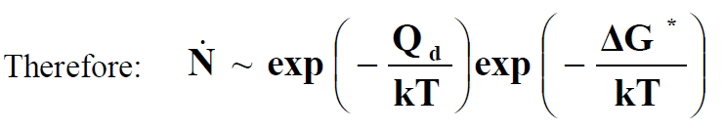
Rate of Homogeneous nucleation
As T ↓ → ΔT ↑ → ΔG* ↓
→exp(-(ΔG*)/kT) ↑
→ ν_{d} ↓

Slide 12
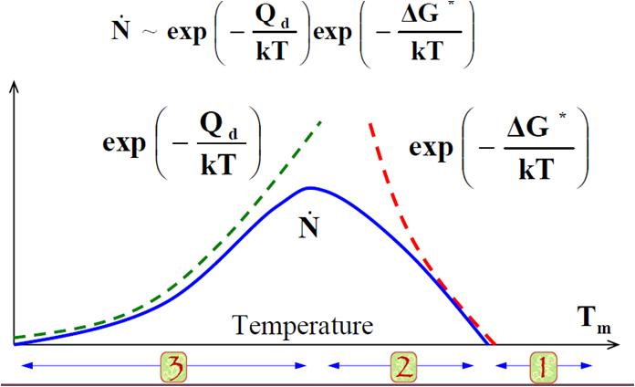
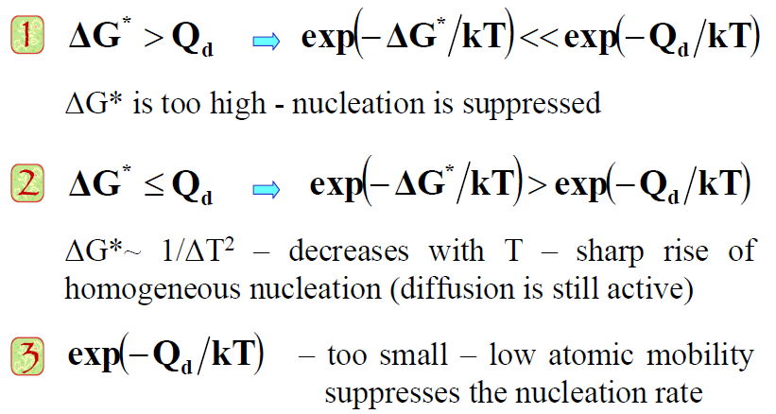
Rate of Homogeneous nucleation

Slide 13
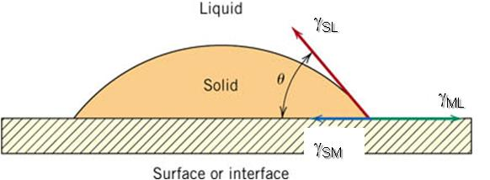
Heterogeneous nucleation

Slide 14
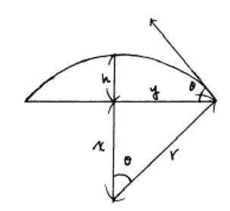

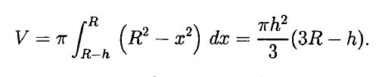

Heterogeneous nucleation

Slide 15

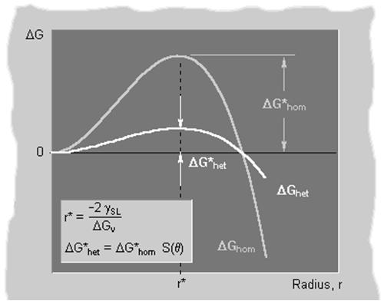


Heterogeneous nucleation

Slide 16
Variation of S(θ) with θ
ΔG*_{hetero} (0º) = 0 no barrier to nucleation
ΔG*_{hetero} (180º) = ΔG*_{homo} no benefit
ΔG*_{hetero} / ΔG*_{homo} →
ΔG*_{hetero} (90º) = ΔG*_{homo}/2
Complete wetting
Partial wetting
No wetting
θ (degrees) →

Slide 17
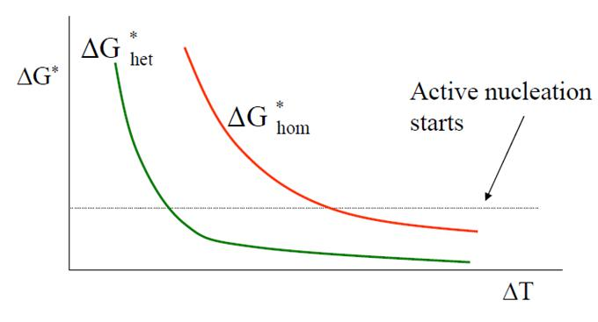
Solidification: Nucleation Processes
Homogeneous nucleation
nuclei form in the bulk of liquid metal
requires supercooling (typically 80-300°C max)
Heterogeneous nucleation
Nuclei form on mold wall or inoculants
allows solidification with only 0.1-10ºC supercooling

Slide 18
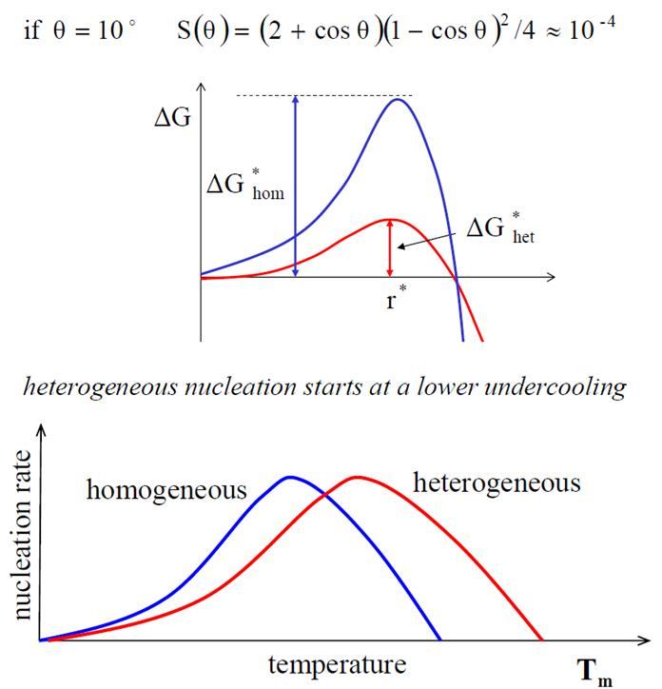
Nucleation rate

Slide 19
Nucleation rate: Homogeneous vs. Heterogeneous
= f(number of nucleation sites)
~ 10⁴²
= f(number of nucleation sites)
~ 10²⁶
BUT the exponential term dominates
I_{hetero} > I_{homo}

Slide 20
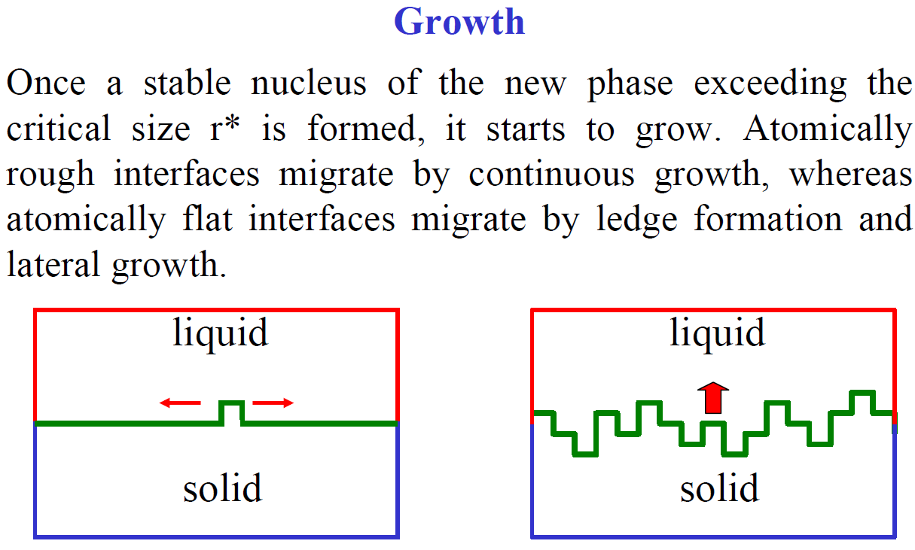
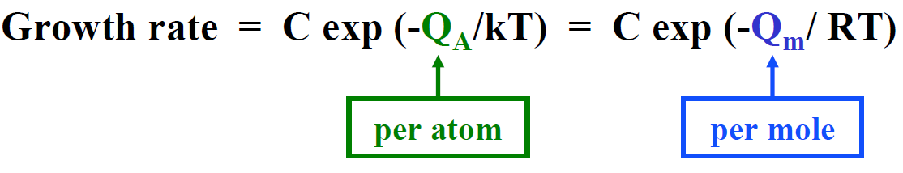

Slide 21
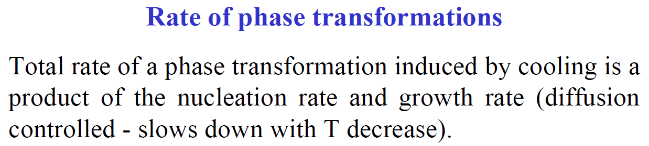
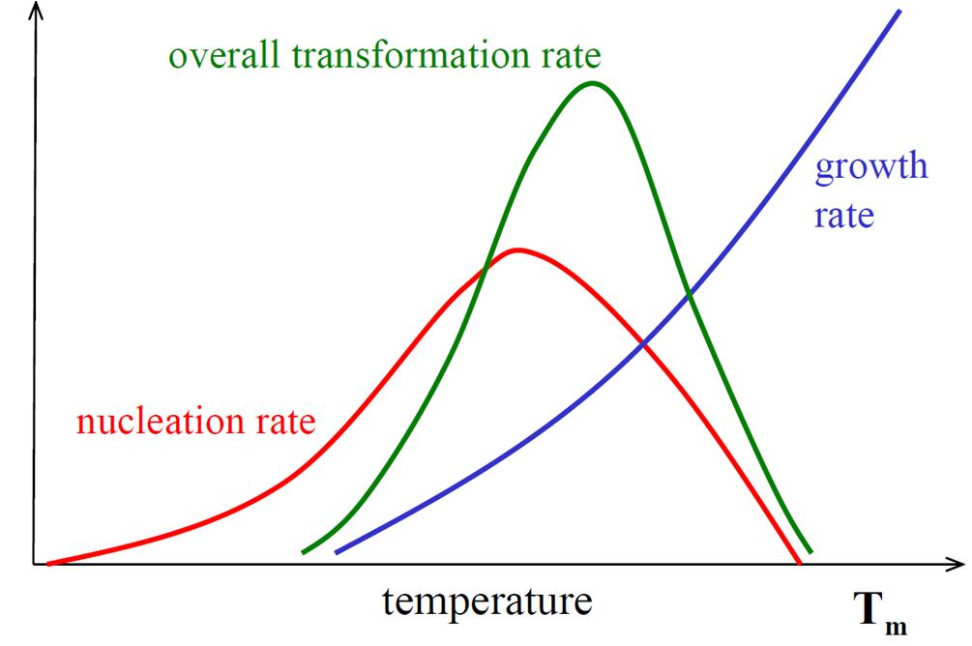

Slide 22

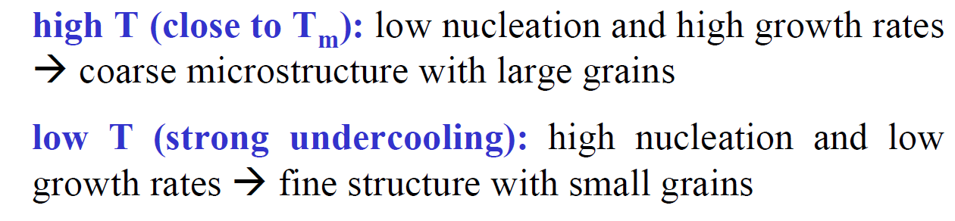
Rate of Phase Transformation

Slide 23
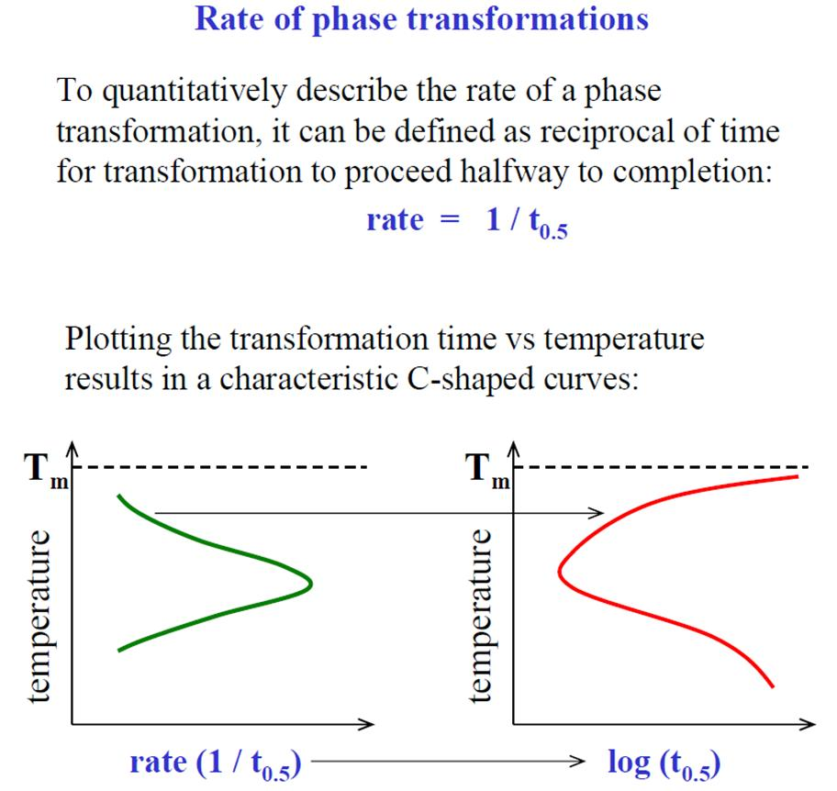

Slide 24
Time – Temperature – Transformation (TTT) diagram α → β phase transformation
Increasing % transformation
β
T (K) →
99% = finish
α
1% = start
t (sec) →

Slide 25
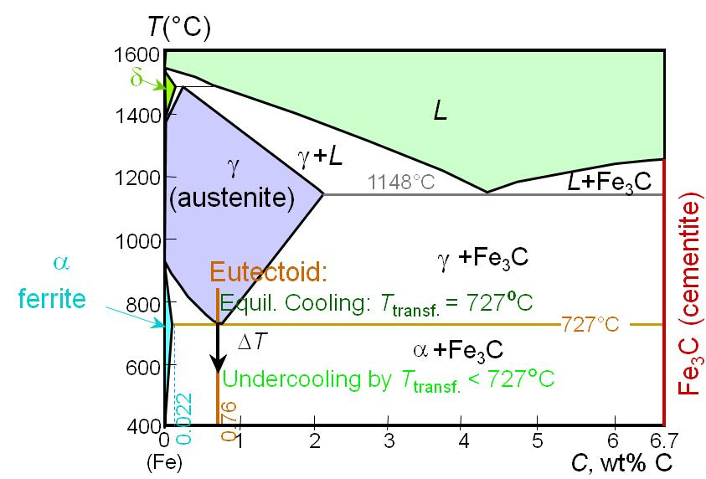
Transformations & Undercooling
•
Eutectoid transformation (Fe-Fe₃C system):
γ
⇒
α
+
Fe₃C
•
For transformation to occur, must cool to below 727°C
0.76 wt% C
6.7 wt% C
0.022 wt% C

Slide 26
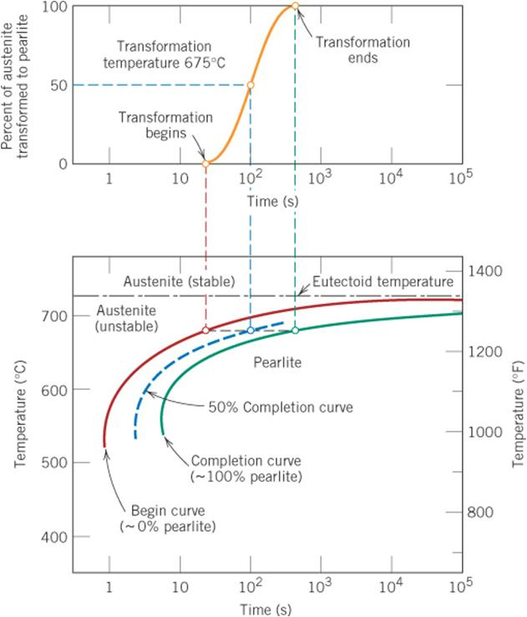
c11f13
Isothermal Transformation Diagrams
2 solid curves are plotted:
one represents the time required at each temperature for the start of the transformation;
the other is for transformation completion.
The dashed curve corresponds to 50% completion.
The austenite to pearlite transformation will occur only if the alloy is supercooled to below the eutectoid temperature (727˚C).
Time for process to complete depends on the temperature.

